Slide 1
SNPWG
Vision from Norfolk 2009

Slide 2
Steps
Agree Wiki by silence. Fill NPUBS register
Product specifications – 3 themes
Define area of interest
Create really simple data sets
Amend ECDIS kernel to accept data
Offer to Interschalt to comment
Debrief results
Feedback – try again and investigate different theme

Slide 3

Nautical information domain
Product specification
Scope
Feature Catalogue
Application schema
Define limit of sample product
Simple data sets
Amend ECDIS kernel
7Cs ?
Jeppesen ?
Other ?
3 themes
Try in Interschalt / Elsewhere

Slide 4
Candidate Sample Themes
Pilotage (Geo point & Info)
Waterway (Geo line)
Marine Protected Area (Geo area & Info)

Slide 5
Nautical information scope
Feedback
Try other themes
3 themes

Slide 6
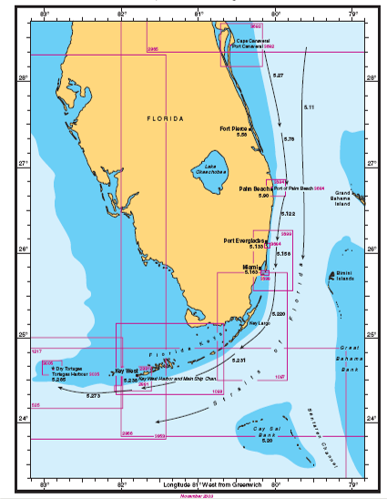

Slide 7
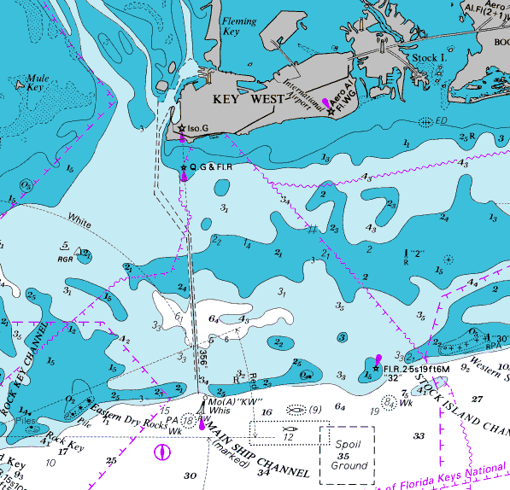

Slide 8
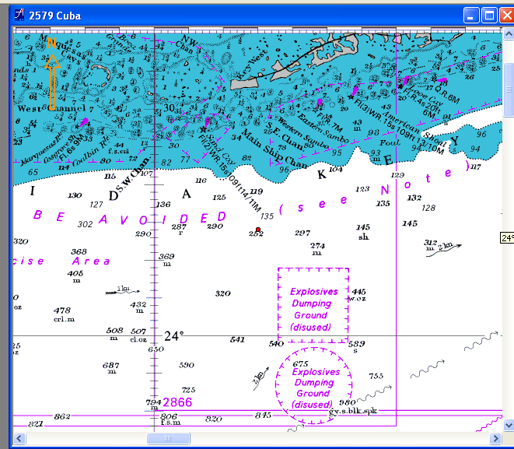

Slide 9
Work item leads
Sample Product specifications
  Pilotage Eivind / Ernie
  Waterway Jens / Olav
  MPA Craig / David
Data sets
  Pilotage David / Alain
  Waterway Tom / Chris
  MPA Craig / ? Arwen ?

